Slide 1
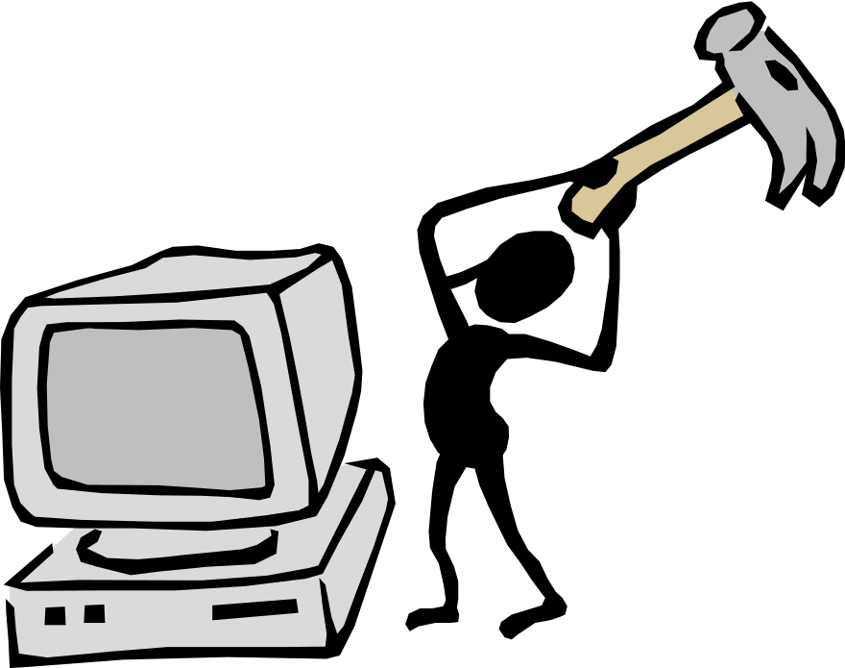
CSE 515 – Software Engineering & Information System Design
A. H. M. Sajedul Hoque
Assistant Professor
Computer Science & Engineering
University of Chittagong

Slide 2
Lecture 5, 6, 7 & 8
Software Processes

Slide 3
Outline
Software Development Life Cycle (SDLC)
Typical stages of SDLC
SDLC models
Waterfall Model
Iterative and Incremental Model
Spiral Model
Predictive and Adaptive Approach
Agile Model

Slide 4
Software Development Process
A set of related activities which lead to the production of a high quality software product
It is also called Software Development Life Cycle (SDLC)
There is no ideal process
Different organizations have developed completely different approaches to software development

Slide 5
Software Development Process or SDLC
Aims to produce high quality software that
  Meets or exceeds customer expectation
  Reaches completion within times and cost estimates
Software Development Life Cycle (SDLC) defining tasks performed at each step in the software development process
ISO/IEC 12207 is an international standard for SDLC
That defines all the tasks required for developing and maintaining software
http://www.tutorialspoint.com/sdlc/sdlc_overview.htm

Slide 6
Typical Stages of SDLC
Planning & Requirement Analysis
Deployment & Maintenance
Defining Requirements
To make SRS document
Performed by senior member of the team with inputs from
Customer
Domain Expert
Sales department
Market Surveys
To conduct feasibility study
Testing
Identification of risks and plan for handling risks
Economical areas
Operational areas
Designing
To make project plan
Technical Areas
Defines the architectural Module of the product
Communication and Data flow representation with the external and third party (if any)
Internal design must be defined clearly
To make Design Document Specification
Reviewed by stakeholders
Risk assessment
Product validity /Robustness
Design Modularity
Time and Budget constraints
Best Design Approach
Until product reached the quality standards
Subset of all stages
Building
The Programming Code is generated as DDS
Developer follow the coding guidelines defined by their organization and Programming tools
Programming Tools: Compiler, Interpreters and Debuggers
Programming Language is chosen with respect to the type of software being developed
Development starts

Slide 7
Software Process/SDLC Model
Waterfall Model
Iterative Model
Spiral Model
V-Model
Big Bang Model
Agile Model
RAD Model
Software Prototype

Slide 8
Waterfall Model
This model was proposed by Royce in 1970
It is also called linear sequential life cycle model
Steps or Phases are arranged in linear order
  A step take input from previous step, gives output to the next step (if any)
  Exit criteria of a step must match with entry criteria of succeeding step
Phases are not overlapped
Different people work in different phase

Slide 9
Waterfall Model
  Four documents are produced
  1. Problem Definition Document
  2. Feasibility Report
  3. Project Plan
Requirement Analysis
  4. SRS documents
  Understand the overall context of the problem
  What Kind of information is involved
  What kind of data is involved
  What functions need to be performed
  What are the performance and interfacing requirement
System Design
  Design Database
  Translate the requirements into Software Architecture
  Prepare Design Document
Implementation
  Each unit is developed and tested for its functionality
Testing
  All units developed in Implementation Phase are integrated into a system
  Entire System is tested for any faults and failures
Deployment
  The product is deployed in the customer environment or released in market
  Some issues or changes arias in customer or client environment are maintained
Maintenance

Slide 10
When Waterfall Model is Applicable
Product definition is stable.
Requirements are very well documented, clear and fixed.
There are no ambiguous requirements.
Technology is understood and is not dynamic.
Ample resources with required expertise are available to support the product.
The project is short.

Slide 11
Advantages of Waterfall Model
Simple and easy to understand and use
Easy to manage due to the rigidity of the model.
Each phase has specific deliverables and a review process.
Phases are processed and completed one at a time.
Works well for smaller projects where requirements are very well understood.
Clearly defined stages.
Well understood milestones.
Easy to arrange tasks.
Process and results are well documented

Slide 12
Disadvantages of Waterfall Model
No working software is produced until late during the life cycle
Poor model for long and ongoing projects.
Not a good model for complex and object-oriented projects.
It is difficult to measure progress within stages.
Cannot accommodate changing requirements.

Slide 13
Iterative and Incremental Model
Iterative process
  It starts with a simple implementation of a subset of the software requirements and
  Iteratively it enhances the evolving versions until the full system is implemented
  It does not attempt to start with a full specification of requirements.

Slide 14
Iterative and Incremental Model
Iterative Model
  Construct a subset of software requirements
  Iteratively enhances the evolving versions until the implementation of full system
At each iteration
  Design modifications are made
  new functional capabilities are added
The basic idea behind this method is to develop a system
  through repeated cycles (iterative) and
  in smaller portions at a time (incremental)

Slide 15
Iterative and Incremental Model
Incremental Model
  The whole requirement is divided into various builds
  During each iteration, the development cycle goes through
    Design
    Implementation
    Testing Phases
  Each subsequent release of the module adds function to the previous release
  The process continues till the complete system is ready as per the requirement
Iterative and incremental Model combination of
  Iterative method
  Incremental build model

Slide 16
Iterative and Incremental Model
Requirement Analysis
System Design
Implementation
Testing
Release 1
Requirement Analysis
System Design
Implementation
Testing
Release 2
Requirement Analysis
System Design
Implementation
Testing
Release 3

Slide 17
Iterative and Incremental Model Application
Requirements of the complete system are clearly defined and understood
Major requirements must be defined and some functionalities or requested enhancements may evolve with time
A new technology is being used and is being learnt by the development team while working on the project
Resources with needed skill set are not available and are planned to be used on contract basis for specific
There are some high risk features and goals which may change in the future

Slide 18
Advantages of Iterative Model
Some working functionality can be developed quickly and early in the life cycle
Results are obtained early and periodically
Progress can be measured
It is easier to find functional or design flaws
Finding issues at an early stage of development enables to take corrective measures in a limited budget

Slide 19
Disadvantages of Iterative Model
It is applicable only to large and bulky software development projects
More resources may be required
More management attention is required

Slide 20
Software Prototype
It refers to building software application prototypes which
  displays the functionality of the product under development
  but may not actually hold the exact logic of the original software
Software prototyping is becoming very popular as a software development model,
  as it enables to understand customer requirements at an early stage of development
It helps
  get valuable feedback from the customer
  software designers and developers understand about what exactly is expected from the product under development

Slide 21
Software Prototype
the very basic requirements are showcased and user interfaces are provided
Prototyping
Requirement Analysis
Design
Customer Evaluation
Customer satisfied
Review & Updating
Feedback is collected
Maintenance
Testing
Development

Slide 22
Software Prototype Application
When used
  Software Prototyping is most useful in development of systems having high level of user interactions such as online systems
  Systems which need users to fill out forms or go through various screens before data is processed
When not used
  Software that involves too much of data processing and most of the functionality is internal with very little user interface does not usually benefit from prototyping

Slide 23
Software Prototype
Advantages
  Increased user involvement in the product even before its implementation.
  Since a working model of the system is displayed, the users get a better understanding of the system being developed.
  Reduces time and cost as the defects can be detected much earlier.
  Quicker user feedback is available leading to better solutions.
  Missing functionality can be identified easily.
  Confusing or difficult functions can be identified

Slide 24
Software Prototype
Disadvantages
  Risk of insufficient requirement analysis owing to too much dependency on the prototype.
  Users may get confused in the prototypes and actual systems.
  Developers may try to reuse the existing prototypes to build the actual system, even when it is not technically feasible
  The effort invested in building prototypes may be too much if it is not monitored properly.

Slide 25
Spiral Model
Spiral Model is the combination of
  Iterative Model
  Waterfall model
It emphasizes on very high risk analysis
It allows incremental release of the product

Slide 26
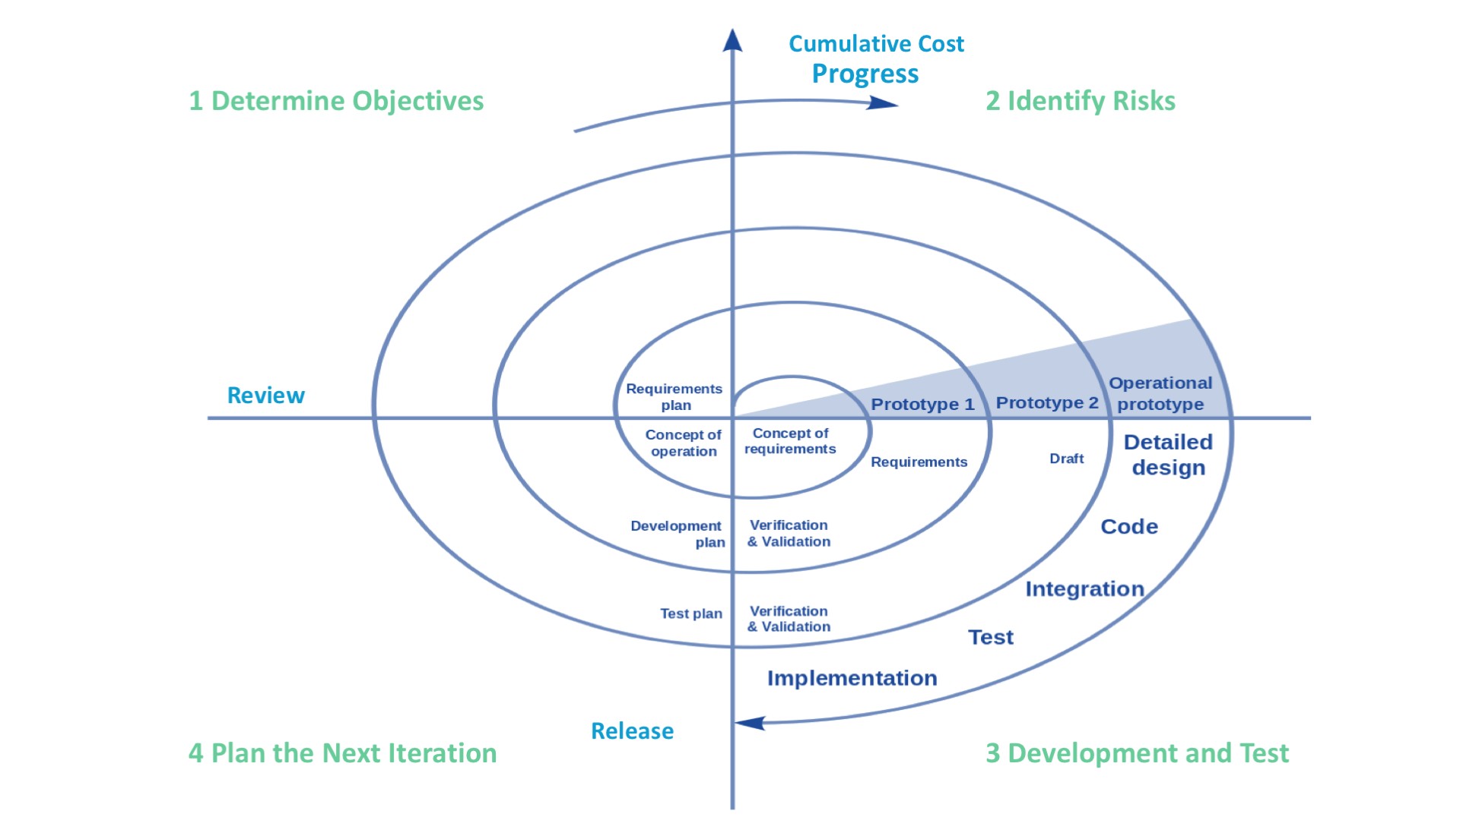
Spiral Model
Study Alternatives relative to objectives and constraints
Objectives: Functionalities, Performance, Hardware/ software interface
Identify Risks: Lack of Experience, New Technology, Tight Schedules, Poor Process
Alternatives: Build, Reuse, Buy, Sub-contract
Constraints : Cost, Schedule, Interface
Resolve Risks
Released software is evaluated
Next iteration is planned
Develop project plan
Develop configuration management plan
Develop a test plan
Develop an installation plan

Slide 27
Spiral Model Application
When there is a budget constraint and risk evaluation is important
For medium to high risk projects
Long term project commitment because of potential changes to priorities as the requirements change with time
customer is not sure of their requirements
Requirements are complex and need evaluation to get clarity
New product line which should be released in phases to get enough customer feedback

Slide 28
Advantages of Spiral Model
Changing Requirements can be accommodated
Allows for extensive use of Prototypes
Requirements can be captured more accurately
Users see the system early
Development can be divided into smaller parts and more risky parts can be developed earlier which helps better risk management

Slide 29
Disadvantage of Spiral Model
Management is more complex
End of the project may not be known early
Not suitable for small or low risk project and could be expensive for small project
Process is complex
Large number of intermediate stages requires excessive documentation

Slide 30
Predictive Approach
It usually works with detailed planning
It has a complete forecast of the exact tasks and features to be delivered in next few months
It entirely depends on the requirement analysis and planning done in the beginning of cycle
Any changes to be incorporated go through a strict change control management and prioritization
Example of Predictive Approach is Waterfall Model

Slide 31
Adaptive Approach
It usually works without any detailed planning
There is clarity on future tasks only in respect of what features need to be developed
There is feature driven development
The team adapts to the changing product requirements dynamically
The product is tested very frequently, through release iterations, minimizing the risk of any major failures in future
Example of Adaptive Approach is Agile Model

Slide 32
Agile Model
Agile SDLC model is a combination of iterative and incremental process models
It focuses on process adaptability and customer satisfaction by rapid delivery of working software product
It breaks the product into small incremental builds which are provided in iterations
Each iteration typically lasts from about one to three weeks
Every iteration involves cross functional teams working simultaneously on various areas like planning, requirements analysis, design, coding, unit testing, and acceptance testing
At the end of the iteration a working product is displayed to the customer and important stakeholders

Slide 33
Agile Model
Agile model believes that every project needs to be handled differently and the existing methods need to be tailored to best suit the project requirements
In agile the tasks are divided to time boxes (small time frames) to deliver specific features for a release
Iterative approach is taken and working software build is delivered after each iteration
Each build is incremental in terms of features
the final build holds all the features required by the customer
Agile thought process had started early in the software development and started becoming popular with time due to its flexibility and adaptability

Slide 34
Agile Model
Planning
Requirement Analysis
Testing
Iteration 1
Planning
Building
Designing
Requirement Analysis
Testing
2-3 Months
Iteration 2
Building
Designing
Planning
Requirement Analysis
Testing
2-3 Months
Iteration 3
Building
Designing

Slide 35
Agile Model
Customer interaction is the backbone of Agile Model
Open Communication with minimum documentation are the typical features of Agile Model
The Agile teams work in close collaboration with each other and are most often located in the same geographical location

Slide 36
Methods of Agile Model
The most popular agile methods include
  Rational Unified Process (1994)
  Scrum (1995)
  Crystal Clear
  Extreme Programming (1996)
  Adaptive Software Development
  Feature Driven Development and
  Dynamic Systems Development Method (DSDM) (1995)
These are now collectively called Agile Methodologies

Slide 37
Agile Model’s Principles
Individuals and interactions - in agile development, self-organization and motivation are important, as are interactions like co-location and pair programming
Working software - Demo working software is considered the best means of communication with the customer to understand their requirement, instead of just depending on documentation
Customer collaboration - As the requirements cannot be gathered completely in the beginning of the project due to various factors, continuous customer interaction is very important to get proper product requirements
Responding to change - agile development is focused on quick responses to change and continuous development.

Slide 38
Advantages of Agile Model
Is a very realistic approach to software development
In agile development, self-organization and motivation are important, as are interactions like co-location and pair programming
Promotes teamwork and cross training.
Functionality can be developed rapidly and demonstrated.
Delivers early partial working solutions.
Enables concurrent development and delivery within an overall planned context
Little or no planning required
Easy to manage
Gives flexibility to developers

Slide 39
Disadvantages of Agile Model
It depends on customer interaction, so if customer is not clear, team can be driven in wrong direction
There is very high individual dependency, since there is minimum documentation generated
Transfer of technology to new team members may be quite challenging due to lack of documentation

Slide 40
END

